Slide 1
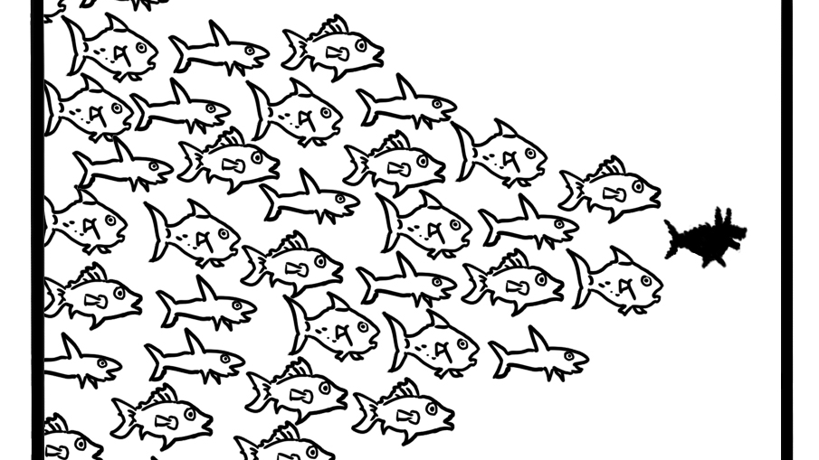
Recycling
Association of North Carolina
August, 2019

Slide 2

Meet ScrapDog

Slide 3
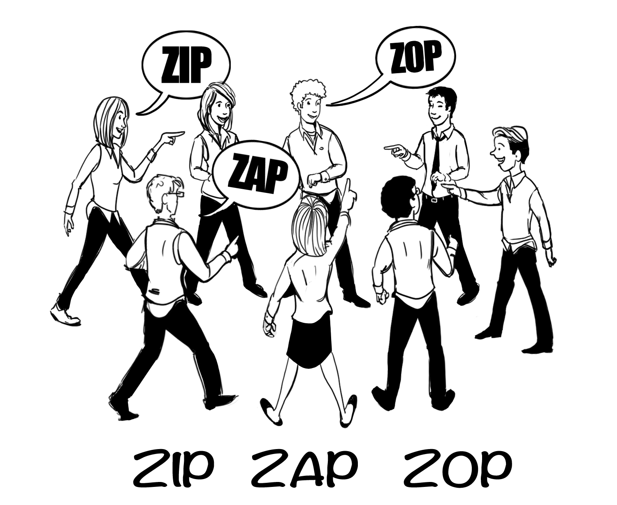

Slide 4
Business Challenges
Low level of unemployment
Employee retention
Growth in tough markets
Finding time and dollars for training
Four generations in the workforce

Slide 5
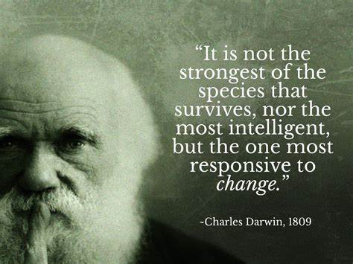

Slide 6
Values Matter
Care
Assist
Respect
Trust

Slide 7
How would people in your company describe you?
1.
2.
3.
4.
5.

Slide 8
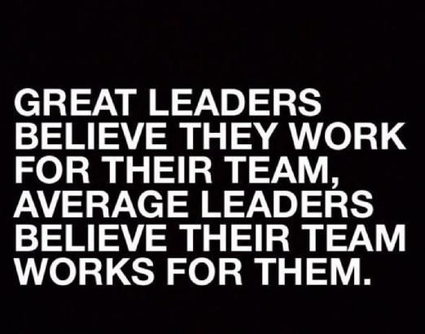
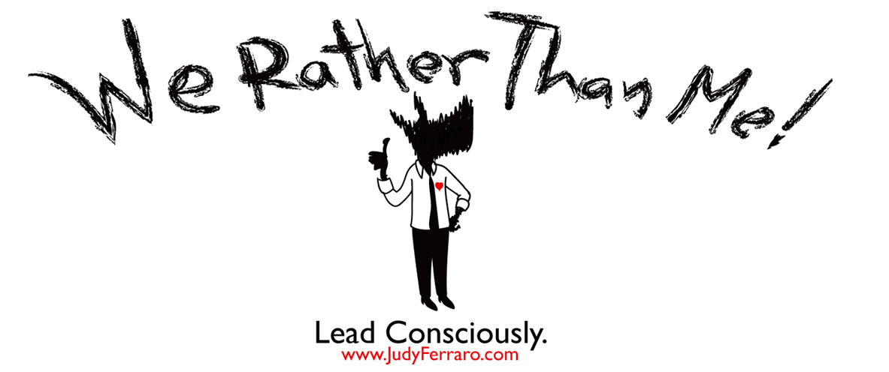

Slide 9





Be the Company – Be the Culture

Slide 10
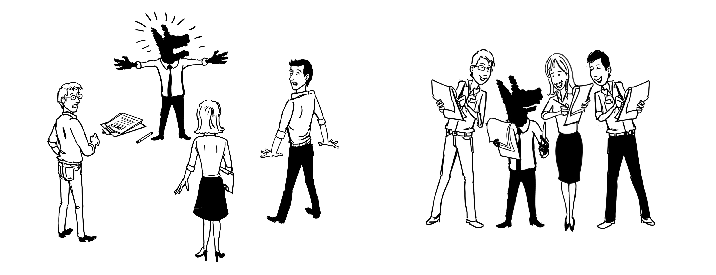
Build a High Trust Organization

Slide 11
High Trust Organizations
…Science Has Spoken
Enjoy their jobs 60% more
Are 70% more aligned with their companies' purpose
Felt 66% closer to their colleagues
Had 11% more empathy for their workmates
Experienced 40% less burnout from their work
Earn 17% more than those working at low-trust organizations

Slide 12
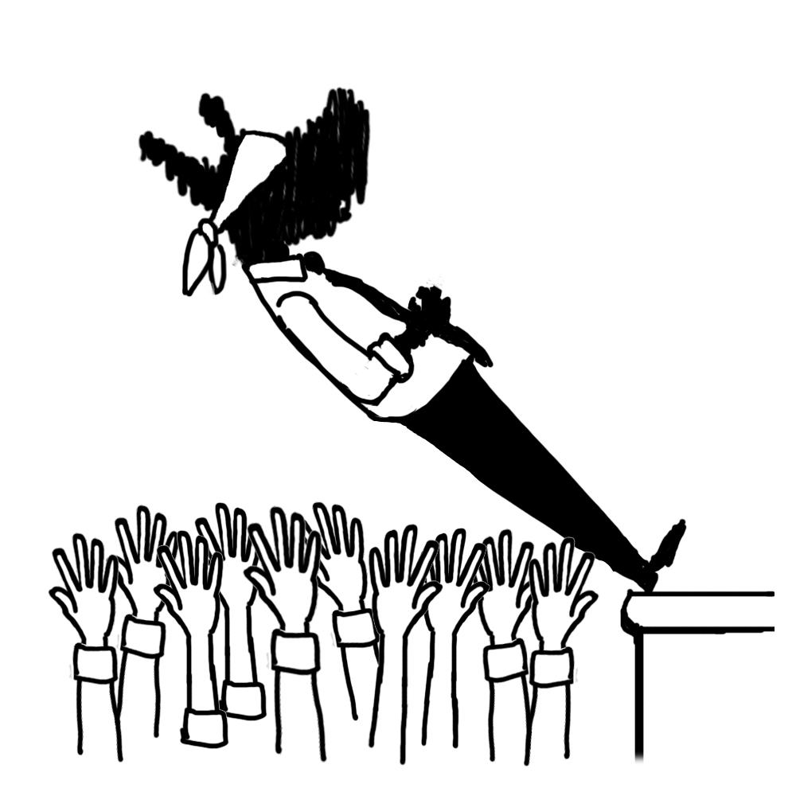
Trust Builders – The Golden Rule
Actively listen
Consistently, do what you say
Tell the truth, even white lies will do harm
Don’t avoid but communicate problems
Show vulnerability
Say things in a respectful way you won’t regret
Share the workload
Be a team player
Don’t fly off the handle
Resist talking negatively about others
Treat others how you want to be treated

Slide 13
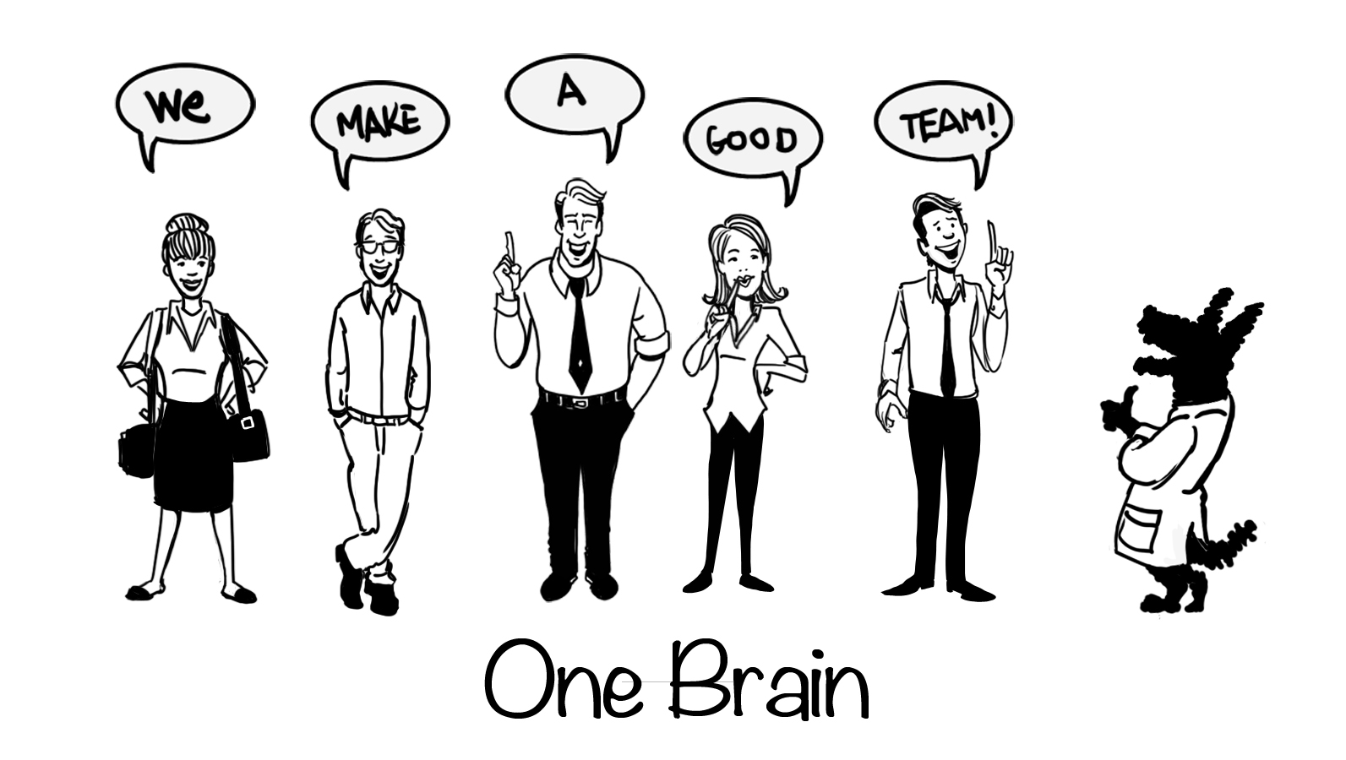

Slide 14

Relationships Matter
Leaders with strong employee relationships have significantly less stress
Employee satisfaction increases by 50% when a worker develops a close relationship at work
22% of employees are less engaged at work because of workplace conflicts
Only 5% of workers strongly agree that their organization helps them build stronger personal relationships

Slide 15

Workplace Relationship Builders
Trust
Communication
Collaboration
Diversity / Inclusion
Respect
Empathy & Compassion
What do you do to build relationships?

Slide 16
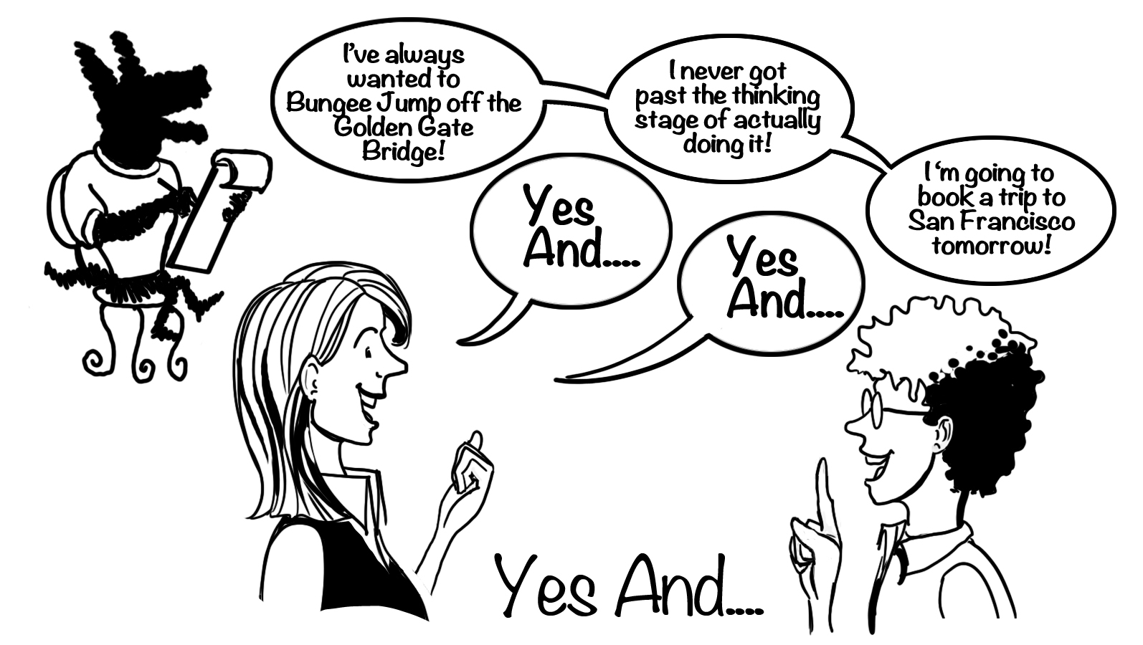
Build a “Yes And” Work Culture

Slide 17
Listening Matters
If you are talking more that 20% of the time, you may not be a good listener.
If you are annoyed at people interrupting you, it may because they are desperately trying to get a word in
If your explanations/stories take up too much time, be aware and “land the plane” sooner
Don’t use weak filler words to keep the floor

Slide 18
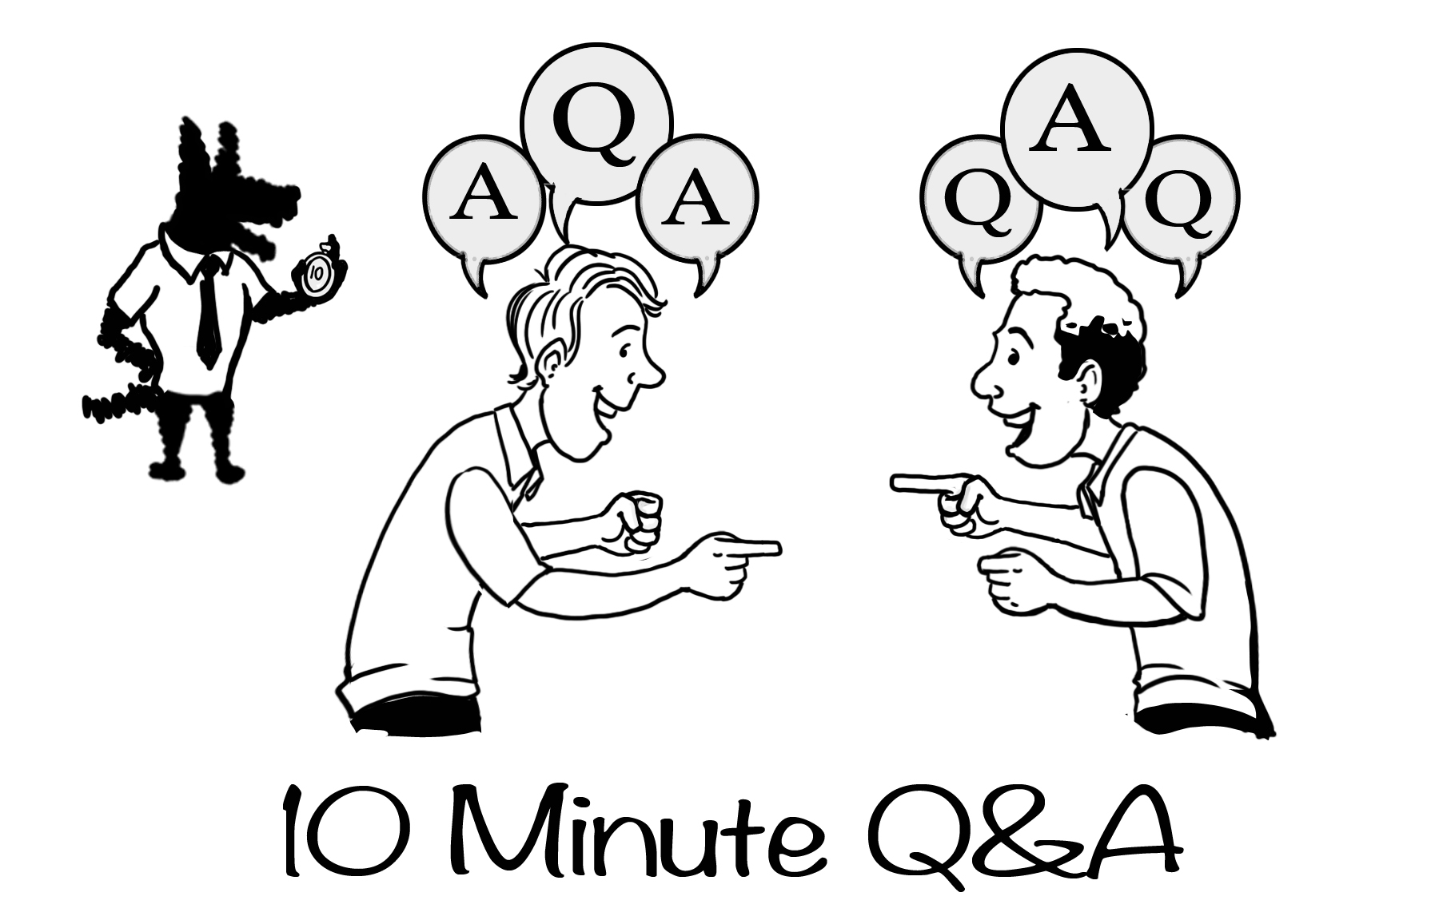
Communicate by
Intentionally Building Relationships

Slide 19


Slide 20
