Slide 1
Argus RGB color palette (Delete when final)
108/173/223
77/77/77
0/93/170
246/246/246
179/179/179
40/40/40
US scrap metal markets: Tariffs and trade wars
Recycling Association of North Carolina Annual Meeting
Blake Hurtik
9 August 2019
Cut unnecessary maps, slides and margin notes before delivery!
Notes:
Please ensure you are using the right template – 16x9 is better for digital/projection/webinar use, 4x3 is better for printed/in-person uses.
Delete the color palette and notes from this page when you’ve finalized your presentation.
One item from lower right should be highlighted here and in section dividers: Choose Market Reporting, Consulting or Events.

Slide 2
Argus Media group notices
The Argus Media group (referred to herein as “Argus”) makes no representations or warranties or other assurance, express or implied, about the accuracy or suitability of any information in this presentation and related materials (such as handouts, other presentation documents and recordings and any other materials or information distributed at or in connection with this presentation).
The information or opinions contained in this presentation are provided on an “as is” basis without any warranty, condition or other representation as to its accuracy, completeness, or suitability for any particular purpose and shall not confer rights or remedies upon the recipients of this presentation or any other person. Data and information contained in the presentation come from a variety of sources, some of which are third parties outside Argus’ control and some of which may not have been verified.
All analysis and opinions, data, projections and forecasts provided may be based on assumptions that are not correct or which change, being dependent upon fundamentals and other factors and events subject to change and uncertainty; future results or values could be materially different from any forecast or estimates described in the presentation.
To the maximum extent permitted by law, Argus expressly disclaims any and all liability for any direct, indirect or consequential loss or damage, claims, costs and expenses, whether arising in negligence or otherwise, in connection with access to, use or application of these materials or suffered by any person as a result of relying on any information included in, or omission from, this presentation and related materials or otherwise in connection therewith.
The information contained in this presentation and related materials is provided for general information purposes only and should not be construed as legal, tax, accounting or investment advice or the rendering of legal, consulting, or other professional services of any kind. Users of these materials should not in any manner rely upon or construe the information or resource materials in these materials as legal, or other professional advice and should not act or fail to act based upon the information in these materials.
Notes:
This slide must accompany any presentation, but webinars may display it separately before the content presentation.

Slide 3
Agenda
About Argus Metals
Ferrous markets
Nonferrous markets
2019 expectations
Q&A
Notes:
Virtually all presentations should have an agenda up front: the audience will be more engaged if you confirm the content is relevant to them.

Slide 4
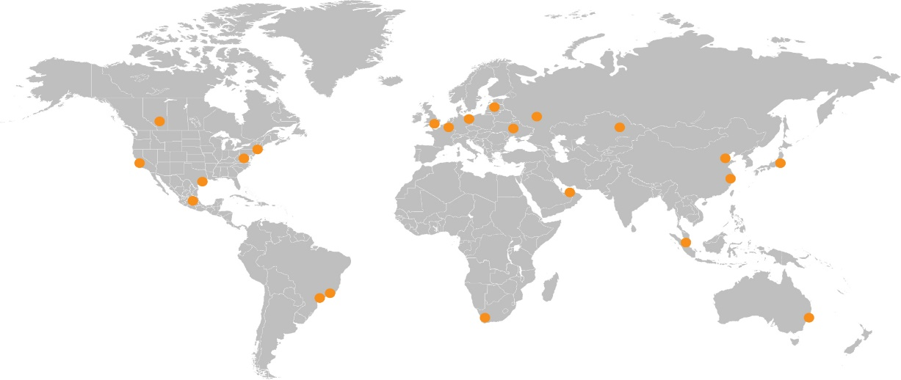




The Argus view
One of the world’s leading PRAs, Argus is a team of nearly 1,000 staff members in 22 global offices
Publishing more than 21,000 daily spot and forward price assessments, plus market intelligence for world commodities markets
Coverage includes:
  Energy
  Fertilizers
  Petrochemicals
  Metals
Services
  Price reporting and indexation
  Consulting
  Conferences
Indexation examples
  US crude oil
  European gasoline
  Asia-Pacific LPG
  Coal
  US and European environmental markets
Notes:
This is the standard description of our company. Our vital statistics and this map was last updated October 2017.

Slide 5
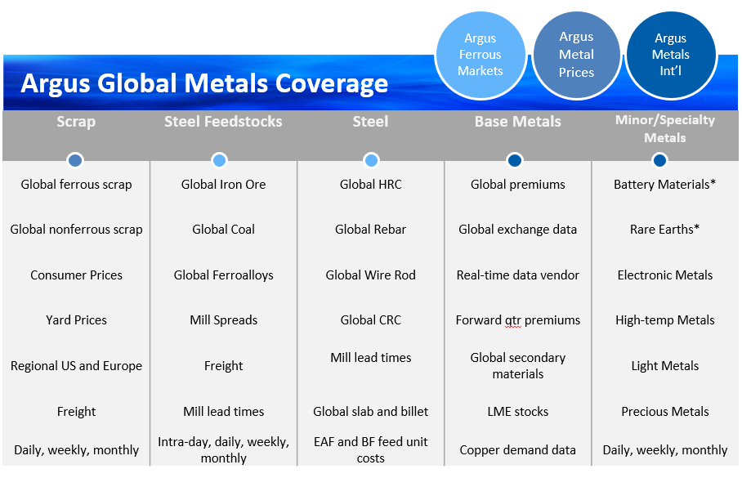

Slide 6
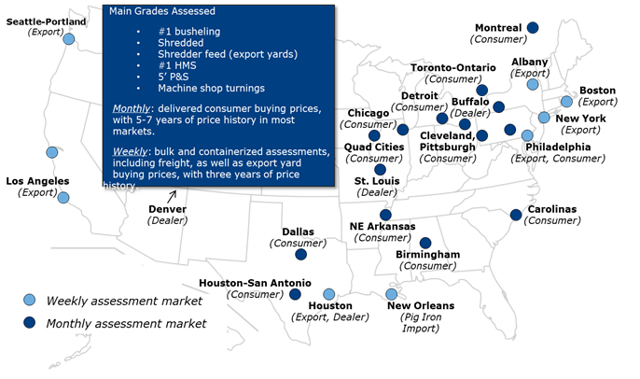
Argus North American ferrous coverage

Slide 7
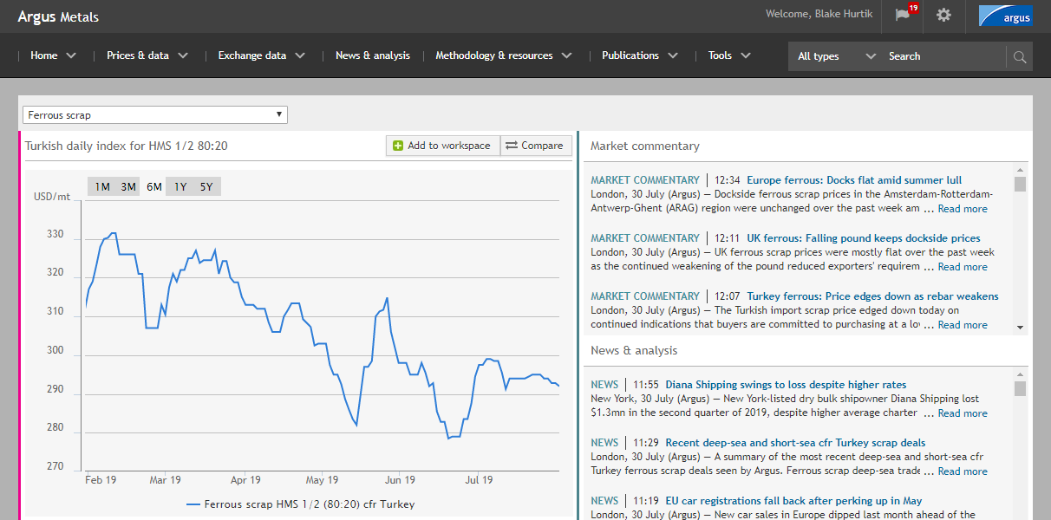
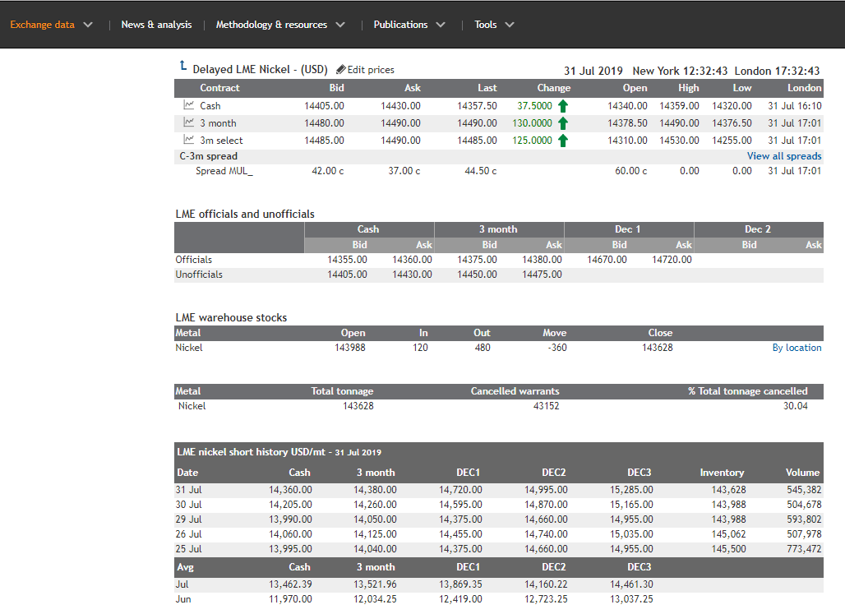
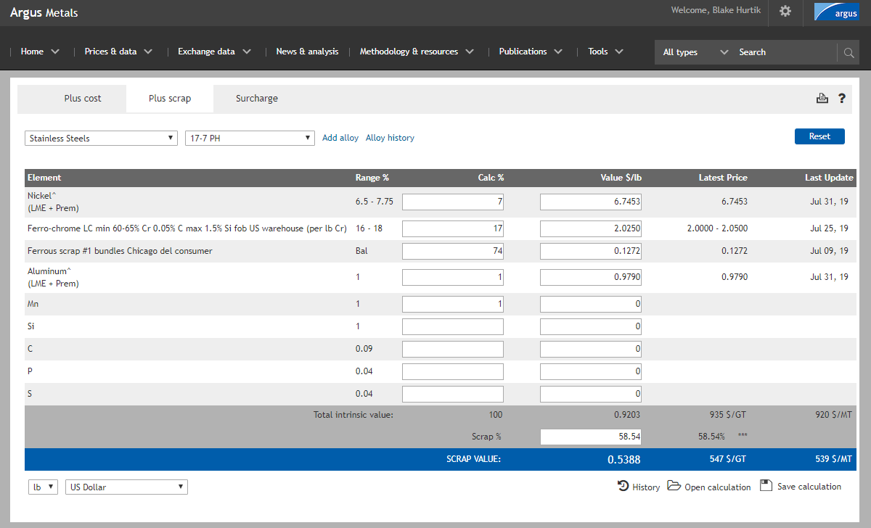
Metals platform

Slide 8
US ferrous scrap
Will relief be temporary?
Notes:
Section divider here, use it to break up your agenda points (Slide 3) into ‘chapters.’ Make sure you’ve highlighted the correct business segment of the lower right three.

Slide 9
US HRC ex-Midwest pricing, $/st
US removes Canada, Mexico from 232, drops Turkey from 50pc to 25pc
Argus RGB color palette (Delete when final)
108/173/223
77/77/77
0/93/170
246/246/246
179/179/179
40/40/40
25pc Section 232 tariff enacted, March 2018
Prices hit lowest since Nov 2016, stabilize after steelmakers announce price hikes

Slide 10
Tariff keeps utilization high, weighs on prices
Argus RGB color palette (Delete when final)
108/173/223
77/77/77
0/93/170
246/246/246
179/179/179
40/40/40
80pc
US Steel idles Gary and Great Lakes blast furnaces
Source: Argus, AISI

Slide 11
Global steel under pressure
$/mt

Slide 12
Domestic scrap faces 2019 pressure

Slide 13
Exports down as US demand rises
YTD US ferrous scrap exports (metric tonnes)
 | 1H 2019 | 1H 2018 | % Change
Turkey | 1,755,097 | 1,646,539 | 7%
Taiwan | 782,641 | 916,587 | -15%
South Korea | 717,853 | 289,797 | 148%
Mexico | 661,187 | 1,037,582 | -36%
Vietnam | 475,300 | 425,531 | 12%
Bangladesh | 452,502 | 351,856 | 29%
Malaysia | 407,401 | 162,848 | 150%
India | 407,005 | 564,568 | -28%
Canada | 352,998 | 335,426 | 5%
Kuwait | 235,791 | 261,216 | -10%
Pakistan | 218,566 | 208,852 | 5%
Peru | 187,256 | 218,205 | -14%
Saudi Arabia | 174,500 | 44,018 | 296%
Egypt | 161,272 | 310,692 | -48%
Thailand | 159,835 | 250,192 | -36%
China | 29,529 | 366,257 | -92%
Total | 7,672,437 | 7,967,638 | -4%
2018 | 2017 | % Change
3,391,709 | 3,635,585 | -7%
1,833,249 | 1,256,046 | 46%
885,485 | 523,367 | 69%
1,728,863 | 1,544,765 | 12%
1,009,601 | 656,409 | 54%
837,963 | 647,026 | 30%
470,397 | 193,861 | 143%
831,969 | 655,413 | 27%
642,865 | 613,959 | 5%
387,143 | 426,332 | -9%
374,628 | 629,098 | -40%
379,136 | 444,086 | -15%
44,038 | 42,892 | 3%
805,028 | 400,273 | 101%
496,464 | 537,648 | -8%
416,897 | 692,101 | -40%
15,664,609 | 13,767,494 | 14%
US Department of Commerce

Slide 14
Focus: East coast export shifts
Sims retakes control from EMR in Aug
US Department of Commerce

Slide 15
Turkey rebar weakness pressures scrap

Slide 16
China iron ore vs Turkey scrap
Prices tumble from 5-year high on trade war hitting currency
Vale mine disaster, Australia maintenance/weather crimp supply

Slide 17
US scrap, metallics imports
Scrap | 1H 2019 | 1H 2018 | % Change
Canada | 1,272,508 | 1,396,500 | -9%
Sweden | 186,176 | 120,309 | 55%
Mexico | 181,611 | 108,597 | 67%
Netherlands | 121,032 | 95,034 | 27%
UK | 49,154 | 117,575 | -58%
Belgium | 48,799 | 377 | A lot
Spain | 10,424 | 22,009 | -53%
All Others | 12,353 | 51,370 | -76%
TOTAL | 1,882,057 | 1,911,771 | -2%
Pig Iron | 1H 2019 | 1H 2018 | % Change
Russia | 1,439,675 | 1,555,199 | -7%
Ukraine | 698,216 | 909,744 | -23%
Brazil | 640,668 | 336,902 | 90%
South Africa | 64,019 | 96,542 | -34%
Italy | 50,520 | -- | --
Canada | 12,176 | 10,305 | 18%
Germany | 3,303 | 2,075 | 59%
All Others | 172 | 40,563 | -99%
TOTAL | 2,908,749 | 2,951,330 | -1%
DRI/HBI | 1H 2019 | 1H 2018 | % Change
Trinidad | 877,848 | 789,152 | 11%
Russia | 73,539 | 81,580 | -10%
Canada | 1,310 | 702 | 87%
Sweden | 387 | 42 | 821%
Venezuela | -- | 33,005 | -100%
Others | -- | 140 | -100%
TOTAL | 953,304 | 904,621 | 5%
US Department of Commerce

Slide 18

Ferrous imports, 1H 2019
Baltimore
55,099t
up 812% y-o-y
Mobile
945,800t
up 1% y-o-y
Beaufort-Morehead City 271,866t
up 11% y-o-y
Charleston
1mn t
up 4% y-o-y
New Orleans
1.9mn t
down 8% y-o-y

Slide 19
Capacity adds/restarts in 232 wake
US Steel
  Restarted idled Granite City blast furnaces
  Planned ~$2bn in upgrades at Mon Valley and Gary Works
  Restarted build of EAF at Fairfield Works in Alabama
Nucor
  $240mn in galvanizing line at Nucor Arkansas
  $650mn expansion at flat-rolled mill in Ghent, Kentucky
  Announced new $1.35bn plate mill to be built in Kentucky
Steel Dynamics
  Announced new $1.8bn flat-rolled mill in Sinton, Texas
  $140mn in galvanizing line at Columbus, Mississippi, mill
  Bought Heartland Steel in Indiana for $400mn

Slide 20








Focus: SDI’s Texas “import killer”
SDI Sinton (3mn t/yr capacity) flat-rolled mill
Near Corpus Christi port (Voestalpine HBI)
Only flat-rolled, EAF mill in Texas
Local busheling demand to increase
Existing EAF-based mills make long/bar products

Slide 21
Nonferrous markets
Trade war and China restrictions
Notes:
Section divider here, use it to break up your agenda points (Slide 3) into ‘chapters.’ Make sure you’ve highlighted the correct business segment of the lower right three.

Slide 22
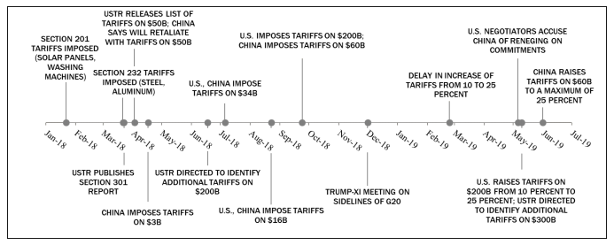
A quick trade war primer…a developing situation
Aug 1: Trump says another $300bn will start in Sep
China allows currency to weaken to lowest since 2008
Source: US-China Economic and Security Review Commission

Slide 23
The evolution of China’s scrap import policy

Slide 24
A trade war tale, as told by Comex copper

Slide 25
China’s scrap metal misnomer problem
Argus RGB color palette (Delete when final)
108/173/223
77/77/77
0/93/170
246/246/246
179/179/179
40/40/40
China’s State Council is targeting a complete ban on imports of solid waste by the end of 2020
Scrap metal is currently classified as a solid waste item
For the nation’s aluminum and copper smelters scrap metal is a crucial, reliable and relatively inexpensive raw material
Stringent guidelines on scrap quality entering the country in 2018 have helped to weed out lower-quality category 7 material which requires dismantling or processing
China’s scrap industry is actively lobbying the government to shift scrap metal from the solid waste category to that of furnace ready raw materials

Slide 26

China issues scrap metal import quotas
China issued two batches of quotas for scrap metal imports valid only for 3Q 2019.
Apply to category 6 scrap aka “furnace ready” like copper chops, larger zorba, twitch.
Scrap importers must reapply for new quota levels each quarter.
Batch one focused on copper scrap importers on the east-central coast.
The second batch concentrated on aluminum scrap importers in southern China.

Slide 27
From metals processor to metals consumer
China scrap import quotas – 3Q 2019 (t)
 | Batch 1 (June 20) | Batch 2 (July 10) | 3Q total | 2016-18 quarterly average
Copper scrap | 240,429 | 124,450 | 364,879 | 776,579
Aluminum scrap | 54,256 | 306,930 | 361,186 | 471,245
Ferrous scrap | 14,968 | 5,550 | 20,518 | 485,871
Copper scrap imports volumes have fallen, the purity has risen, helping offset the decline.
China’s quota and licensing restrictions look to transform it from being a scrap metal processor to a semi-finished metals consumer
Notes:
Tables are fantastic displays of Argus information or fundamentals. Production or demand figures, prices, trade flows all look great in tables.

Slide 28

Neighboring markets rise as China falls
US Exports aluminum and copper scrap, 1H 2019 vs 1H2017
China
South Korea
India
Hong Kong
Taiwan
Thailand
Vietnam
Malaysia
Tariffs and stricter import regulations have shifted US exports from China to neighboring countries
Indonesia
Chinese buyers set have up shop in neighboring countries to process or re-route US material for shipment to China
Some nations are stepping up import restrictions to avoid becoming a dumping ground for metal imports
Trade flows could see more drastic changes following China’s implementation of scrap quotas for all countries, effective July 1, 2019
Notes:
Try not to use bullets. These are almost never the best display for your information: Maps, timelines, tables and charts are more compelling.

Slide 29
And North Carolina?
US Department of Commerce

Slide 30
China policy impact on zorba

Slide 31
Domestic prices feel the pinch, too

Slide 32
Domestic prices feel the pinch, too

Slide 33
Domestic prices feel the pinch, too

Slide 34
Stainless rides the LME nickel wave
$/mt
$/lb

Slide 35
Second half outlook
Notes:
Section divider here, use it to break up your agenda points (Slide 3) into ‘chapters.’ Make sure you’ve highlighted the correct business segment of the lower right three.

Slide 36
2019 things to watch
Ferrous
  HRC able to hold recent gains?
    If not, high-cost capacity (aka blast furnaces) feel pinch
  Mills will look to pressure scrap to retain margins
  Iron ore price correction
General
  Economic headwinds
  Prolonged auto weakness
  Trade war resolution, escalation or stagnation

Slide 37
Notes:
Carefully consider whether you want to use this slide – only include this if you intend to conclude your presentation with a reference to Argus.

Slide 38

Blake Hurtik
Editor, Argus Metal Prices
blake.hurtik@argusmedia.com
+1 (713) 360-7590
Houston
www.argusmedia.com/metals-platform
Stay Connected
@ArgusMedia Argus-media
+Argusmediaplus argusmediavideo
Copyright notice
Copyright © 2019 Argus Media group. All rights reserved. All intellectual property rights in this presentation and the information herein are the exclusive property of Argus and and/or its licensors and may only be used under licence from Argus. Without limiting the foregoing, you will not copy or reproduce any part of its contents (including, but not limited to, single prices or any other individual items of data) in any form or for any purpose whatsoever without the prior written consent of Argus.
Trademark notice
ARGUS, the ARGUS logo, Argus publication titles, and Argus index names are trademarks of Argus Media Limited. For additional information, including details of our other trademarks, visit argusmedia.com/trademarks.
Notes:
Update this slide with your contact details. You must include the copyright, trademark and “Stay Connected” information in the lower third of this slide in your presentation.

