Slide 1
What’s New in the Safety World
August 3rd
RANC Annual Meeting
Wrightsville Beach, NC
Tony Smith - ISRI

Slide 2
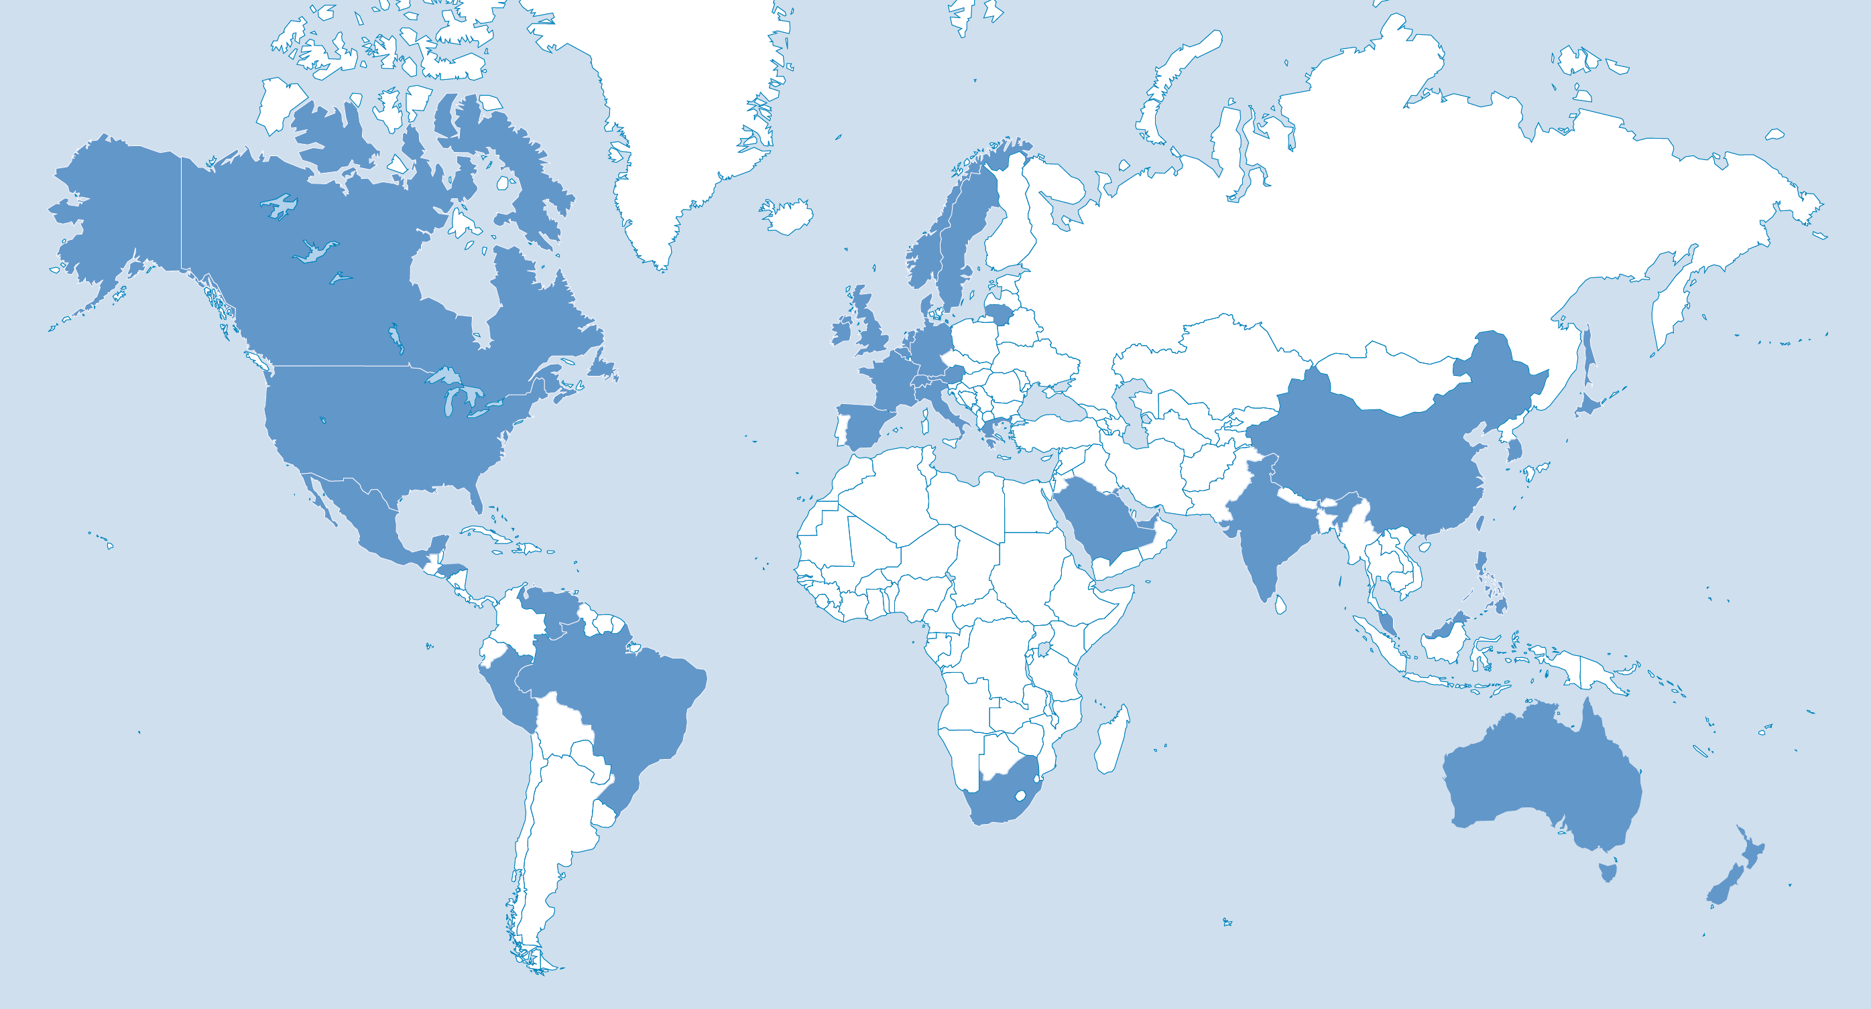
ISRI: Voice of the Recycling Industry
1,300+
Member companies
4,000+
Recycling facilities worldwide
34
Countries
Notes:
Institute of Scrap Recycling Industries (ISRI)
ISRI is an international trade association that represents more than 1,600 member companies that process, broker and consume scrap (ranging from small, family-owned businesses to large, multi-national corporations)
Representing 7,000+ facilities worldwide - that process, broker & consume scrap metals, paper, plastics, glass, textiles, rubber, and electronics.

Slide 3

How are we doing?

Slide 4
OSHA Most Cited Standards
Machine guarding
Lockout/Tagout
Walking and working surfaces
Powered Industrial Trucks
Respiratory Protection
Hazard Communication
Lead
https://www.osha.gov/pls/imis/citedstandard.html
Notes:
Most cited in the region for 2017

Slide 5
OSHA Emphasis Programs
Region IV (AL, FL, GA, KY, MS, NC, SC, TN)
  Fall Hazards
  Powered Industrial Trucks
  Noise Hazards
  Electrical Hazards
  Lead
https://www.osha.gov/dep/leps/leps.html
Notes:
OSHA Emphasis Programs for Region 4
Web link for Emphasis Programs included

Slide 6

Regulatory Activity
Where are we?

Slide 7
Standards Info & Activity
Beryllium
http://www.isri.org/safety/safety-management-program-risps/isri-safety-fact-sheets
Silica, Respirable Crystalline
http://www.isri.org/safety/safety-management-program-risps/isri-safety-fact-sheets
Recordkeeping
https://www.labor.nc.gov/safety-and-health
Walking-Working Surfaces
https://www.labor.nc.gov/safety-and-health

Slide 8
Recordkeeping Rule
Key Dates
December 31, 2017 – upload your 2016 injury & illness data.
July 1, 2018 – have your 2017 injury & illness data uploaded.
March 2, 2019 and every year thereafter – deadline to upload previous year’s injury and illness data.
https://www.osha.gov/injuryreporting/index.html

Slide 9
Recordkeeping Rule
Under OSHA’s electronic recordkeeping rule, covered companies with more than 250 employees must submit information electronically from:
  OSHA Form 300 (Log of Work-Related Injuries and Illnesses)
  OSHA Form 300A (Summary of Work-Related Injuries and Illnesses)
  OSHA Form 301 (Injury and Illness Incident Report)
Covered establishments with 20-249 employees in certain industries with historically high rates of occupational injuries and illnesses must submit information electronically from OSHA Form 300A.

Slide 10
Recordkeeping Rule
OSHA’s website offers three options for employers to submit data:
1. Users will be able to manually enter data into a web form;
2. Users will be able to upload a CSV file to process single or multiple establishments at the same time; and
3. Users of automated recordkeeping systems will have the ability to transmit data electronically with an API (application programming interface).
The data submission process involves four steps:
  1. Creating an establishment;
  2. Adding 300A summary data;
  3. Submitting data to OSHA; and
  4. Reviewing the confirmation email.

Slide 11
Standards Info & Activity
Beryllium
http://www.isri.org/safety/safety-management-program-risps/isri-safety-fact-sheets
Silica, Respirable Crystalline
http://www.isri.org/safety/safety-management-program-risps/isri-safety-fact-sheets
Recordkeeping
https://www.labor.nc.gov/safety-and-health
Walking-Working Surfaces
https://www.labor.nc.gov/safety-and-health

Slide 12
ISRI Safety Oriented Task Groups
Radiation Task Group
Airbag Task Group
Environmental Justice Task Group
Battery Task Group
Fire Task Group
Notes:
Task groups working on industry safety issues.
Radiation group is working with the CRCPD – Committee for Radiation Control Program Directors – we are working on an info E&T pkg w/video
Airbag Task Group is in a holding pattern waiting on a response from mfg groups
Env Justice Task Group is working with members to help them understand how to reach out and get in front of the issues before the issues get them
Battery Task Group is working with the BCI – Battery Council International – BCI is producing a video that they will share with us to stream on ISRI website
Fire Task Group is working with NWRA and SWANA – Nat’l Waste & Recycling Assn and The Solid Waste Assn of North America

Slide 13
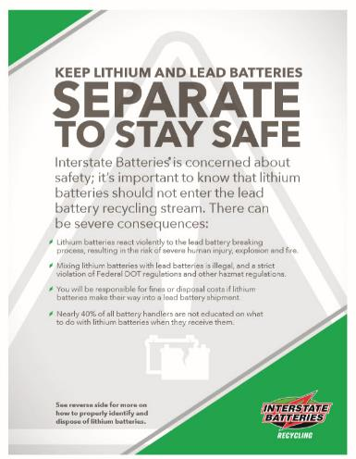

Notes:
This was shared with tony smith by tod lyons of interstate batteries. Tod has requested that ISRI post this on their website as an awareness piece.
Do we need to make a motion or take a vote on adding this to the ISRI website?

Slide 14
ISRI Safety Programs & Outreach
Safety Culture Blueprint
Weekly Tool Box Talks
DOT Self-Assessment
Recommended Industry Safe Practices & Fact Sheets
Harwood Training Grant (Hazard Recognition & Machine Guarding)
Mobile Equipment Train-the-Trainers
ISRI Safety & Environmental Council (ISEC)
Circle of Safety Excellence
Safety Data Sheets
Safety Stand Down Day
http://www.isri.org/safety-best-practices/isri-safety/isri-safety-resources#.WPUR9fkrJAg

Slide 15

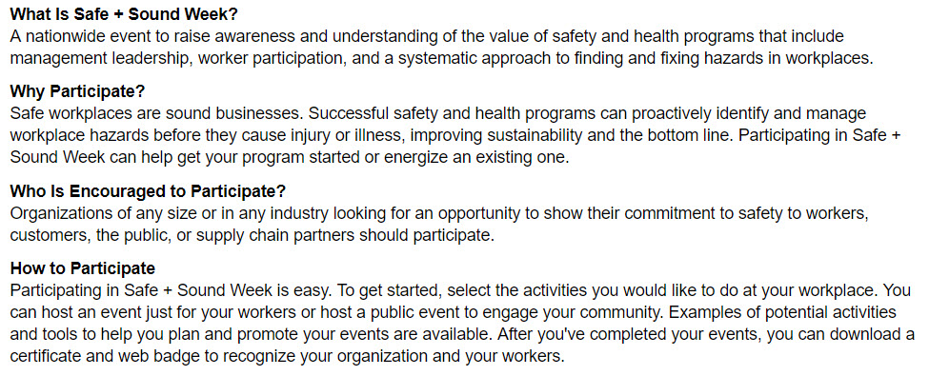
OSHA Safe & Sound Week
August 13 – 19, 2018
https://www.osha.gov/safeandsoundweek/
Notes:
OSHA’s safe and sound week info with web link

Slide 16
Fostering Safety Culture
These are some excellent guidelines for creating a good and sound business anywhere in the world: “Safety is not the absence of injury, safety is the reduction of risk. Show me a business culture that fosters risk reduction at all levels, and I will show you a business with low injury rates. An open and honest safety culture needs management commitment , employee engagement, and accountability. It means that everyone has to be on the same page within the organization. Having safety policies, programs, and procedures in place is great for helping guide the business forward and to keep it in compliance and within the framework of the law, but compliance is not safety—and safety is not compliance. Fostering a safety culture from the top down and from the bottom up should be the goal of all businesses across the scrap recycling spectrum—and around the world. If you can do this, then you will see injury and illness rates decline.”

Slide 17
Resources
Batteries
California Product Stewardship Council - https://calpsc.org/products/batteries/
Call2Recycle - https://www.call2recycle.org/safety/
Webinar - https://www.youtube.com/watch?v=8wM-Ejskwl4&feature=youtu.be
Safety & Environmental
ISRI – http://www.isri.org/safety
Regulatory
NC DOL - https://www.labor.nc.gov/safety-and-health/library
NC DOL - https://www.labor.nc.gov/safety-and-health/publications
NC DEQ - https://deq.nc.gov/
OSHA - https://www.osha.gov/
EPA - https://www.epa.gov/

